Slide 1
Beginning Programming 1 With Python Session2

Slide 2
Exercise
1]
dis=10/1.6
time= 42*60+42
speed=dis/time
print(“speed in miles per second is”,speed)
2]
r=0
pi=3.14159
c=2*pi*r
r=float(input("enter the radius\n"))
print("the circumference is",c)

Slide 3
Errors In Python
Syntax error:
The error in program that is impossible to parse …
Symantec Error:
It makes the program do something other than what programmer intended.
Exception:
It is an error detected while program is running

Slide 4
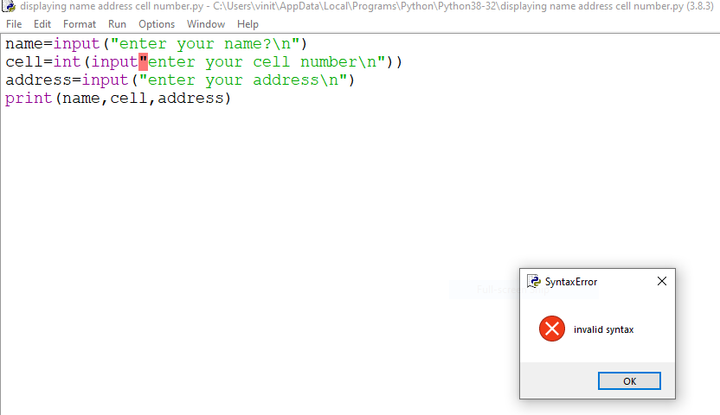
Syntax Errors
Syntax errors prevent code from building
spelling errors, incorrect punctuation, missing parentheses are examples of causes

Slide 5
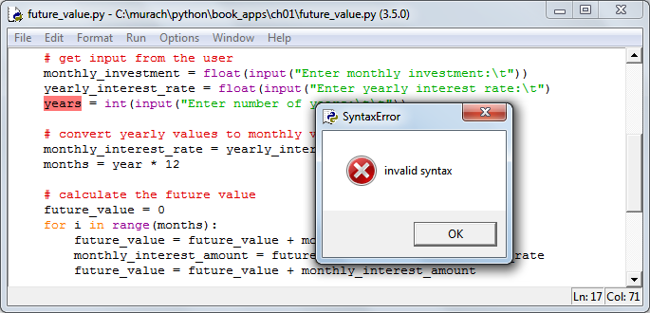
Handling Syntax Errors
IDLE will highlight where it thinks a syntax error has occurred
Sometimes the highlighted location will be correct, but sometimes it will be elsewhere (e.g. in the previous statement)

Slide 6
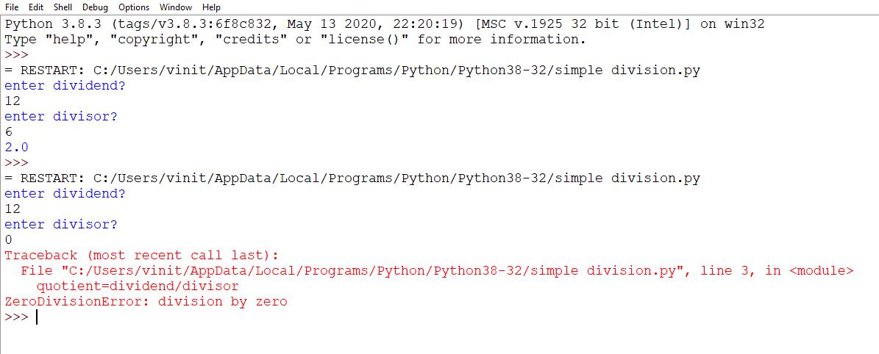
Runtime Errors
Runtime errors can crash your program
There are ways to handle these errors (exceptions) to prevent the crash, but for now we will have to find and fix the code that is causing the crash.

Slide 7
Keyboard input
Python provides a built-in function called input that stops the program and waits for the user to type something.
When the user types and presses return or enter ,the program resumes and input returns what the user types as a string or numeric.
#1
name=input( )
print(name)
name=input ("enter your name\n")
print(name)

Slide 8
To continue…
#2
number= int (input("enter a number\n"))
print(number)
print(type(number))
#3
number= input("enter a number\n")
print(number)
print(type(number))
"\n" is a special character which takes the user to next line

Slide 9
Boolean Data Type
Boolean data type, which is named for the nineteenth century British mathematician George Boole.
The Boolean data type consists of only two data values—
True and False.
Simple Boolean expressions consist of the Boolean values True or False, variables bound to those values, function calls that return Boolean values, or comparisons.
For example, you might compare value A to value B to see which one is greater. The result of the comparison is a Boolean value.

Slide 10
Type As Boolean ……
If we type following command at command prompt,
>>> type(True)
<class 'bool'>
>>> type(False)
<class 'bool'>
We see that bool is the name of the class representing Python’s Boolean expressions.

Slide 11
Boolean expression
An Boolean expression is one that is either true or false
The simplest kinds of Boolean expressions use relational
operators to compare two expressions.
>>> 5=5
>>> true
>>> 5=6
>>> false
x=10
x<10 (result is False) x>=10 (result is True)
x<100 (result is True) x==10 (result is True)
x<5 (result is False) x==7 (result is false)
Write more on boolean

Slide 12
Logical Operators
There are 3 logical operators : AND ,OR ,NOT
The semantics of these operators is similar to their meaning in English
X =7
X>0 AND X>10 (is this true?)
X>5 OR X<10 (is this true)
NOT negates a Boolean expression. A Boolean expression is one that is either true or false

Slide 13
Compound Boolean Expression Truth Table
e1 | e2 | e1 and e2 | e1 or e2 | Not e1
F | F | F | F | T
F | T | F | T | T
T | F | F | T | F
T | T | T | T | F

Slide 14
Consider this….
x= 10
y=20
b=(x==10) and (x!=10)
print(b)
b=(x==10 and y==20)
print(b)
b=(x==10 or y!=20)
print(b)
b=(x!=10 or y!=20)
print(b)

Slide 15
Consider this example …
What is the output of the following snippet?
x = 1
y = 0
z = ((x == y) and (x == y)) or not(x == y)
print(not(z))

Slide 16
Logical Operator Examples, cont.
# AND and OR operators with parentheses to clarify sequence of operations
(age >= 65 and status == "retired") or age < 18
# AND and OR operators with parentheses to change sequence of operations
age >= 65 and (status == "retired" or state == "SC")

Slide 17
Using AND and OR Logical Operator Examples
# The AND operator
age >= 65 and city == "Chicago"
# The OR operator
city == "Greenville" or age >= 65
# Two AND operators
age >= 65 and city == "Greenville" and state == "SC"
# Two OR operators
age >= 65 or age <= 18 or status == "retired"

Slide 18
Compound Boolean Expression Truth Table
e1 | e2 | e1 and e2 | e1 or e2 | Not e1
F | F | F | T | T
F | T | F | T | T
T | F | F | T | F
T | T | T | T | F

Slide 19
Consider this….
x= 10
y=20
b=(x==10) (assigns T to b)
b=(x!=10) (assigns F to b)
b=(x==10 and y==20) (assigns T to b)
b=(x==10 or y!=20) (assigns F to b)
b=(x!=10 or y!=20) (assigns F to b)

Slide 20
Using Conditional Statement
Write a program which uses an if statement that asks the user to input a number and ,
Displays a message at the console if the number is positive?
if the number is positive or negative?
If the number is positive or negative or zero?

Slide 21
Using simple if
num=float(input("enter a number :"))
if num>0:
print("The number is a positive number")

Slide 22
Here is another way…..
num=float(input("enter a number :"))
if num>0:
print(" number is a positive number")
else:
print(" number is a negative number")
The condition in the if-else statement must be a
Boolean expression—that is, an expression that
evaluates to either true or false.

Slide 23
To string together if-else statements
Is there need to check for more than two
possible outcomes ?
It becomes multiway decision statement,
num=float(input("enter a number:"))
if num>0:
print(" number is a positive number")
elif num==0:
print(" number is zero")
else:
print(" number is negative")

Slide 24
General form of if-elif-else
if condition 1:
block 1
elif condition2:
block2
elif condition 3:
block3
else:
default block

Slide 25
Another Nested if example
x=int(input("enter a number\n"))
y=int(input("enter a number\n"))
if x==y:
print(" x is equal to y")
else:
if x<y:
print("x is less than y")
else:
print("x is greater than y")

